Slide 1


Home
About
Contact
SQL STORED PROCEDURE
REY JOHN P. AGUILAR
Start Slide

Slide 2



Home
About
Contact
about
Once you’ve learned how to perform CRUD operations (Create, Read, Update, Delete) using SQL in your programs, the next essential skill is mastering stored procedures. While CRUD teaches you how to interact with data, stored procedures teach you how to manage and organize complex logic within the database itself.
OVERVIEW

Slide 3

Home
About
Contact
Why Learning Stored Procedures Matters After CRUD
Once you've mastered basic CRUD operations, the next step is to learn how to organize and optimize your database logic. This is where stored procedures come in — they help you write cleaner, reusable, and more secure SQL code that's stored directly in the database.

Slide 4
Home
About
Contact
Learning Stored Procedures Matters After CRUD
Organizes Your SQL Logic
Instead of placing long or repetitive SQL code in your application, you can put that logic inside the database using stored procedures. This keeps your application code clean and focused on business flow.
Reduces Repetition
Have a report or function you need to call again and again? With stored procedures, you define the logic once and just call it with different parameters.

Slide 5
Home
About
Contact
Learning Stored Procedures Matters After CRUD
Faster Execution
Since stored procedures are compiled and stored on the server, they usually execute faster than raw SQL queries written repeatedly in your application.
Improved Collaboration
In bigger systems or teams, developers work on frontend and backend separately. Stored procedures give backend developers control over data logic, making teamwork more efficient.

Slide 6
Home
About
Contact
Learning Stored Procedures Matters After CRUD
Prepares You for Advanced Tasks (Like Reports)
Many real-world systems require generating summaries, analytics, and formatted reports. These tasks often involve multiple queries and conditions, which are easier to manage in stored procedures.

Slide 7
Home
About
Contact
What is Stored Procedure in SQL?
A stored procedure in SQL is a collection of SQL statements saved and stored within the database. The purpose of the SQL stored procedure is to perform a sequence of operations on a database, such as querying, inserting, updating, or deleting data.
Unlike regular SQL queries, executed as separate commands, stored procedures encapsulate a set of SQL statements, making it easy to reuse the code without having to write SQL commands repeatedly.

Slide 8
Home
About
Contact
The benefits of SQL stored procedures include the following:
Code reusability: Once a stored procedure is created, it can be called as many times as needed, eliminating redundancy in SQL code.
Enhanced performance: Stored procedures often execute faster because they are precompiled and stored on the database server, reducing network latency and compilation time.
Security: Stored procedures can improve data security and control over sensitive data access by granting users permission to execute a stored procedure without direct access to tables.

Slide 9
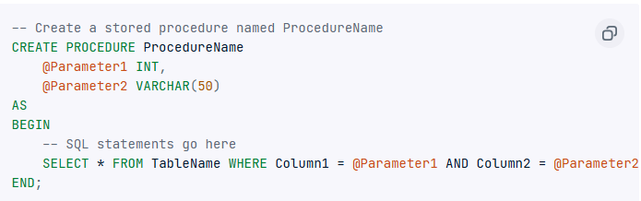
Home
About
Contact
Basic syntax and structure
The syntax for creating a stored procedure may vary slightly depending on the database system (e.g., MySQL, SQL Server, Oracle). Below is a general example using SQL Server syntax:

Slide 10
Home
About
Contact
Basic syntax and structure
CREATE PROCEDURE: This command is used to define a new stored procedure.
ProcedureName: The name given to the stored procedure. It should be unique within the database.
@Parameter1, @Parameter2: Parameters are optional; they allow the procedure to receive data inputs. Each parameter is defined with a @ symbol and a data type (e.g., INT, VARCHAR(50)).
AS BEGIN...END: The SQL statements within BEGIN and END form the body of the procedure, where the main logic is executed. The procedure retrieves records from a table based on specific conditions in this example.

Slide 11
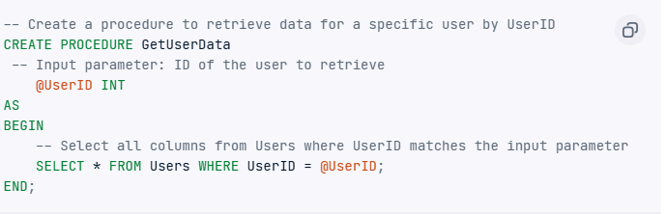
Home
About
Contact
Input and output parameters
The input and output parameters allow you to pass values to and from a stored procedure.
For example, if @Parameter1 is defined as an input parameter, it can be assigned any value when the procedure is called, affecting the SQL logic or output. In the example below, the @UserID parameter retrieves data specific to the provided UserID.

Slide 12
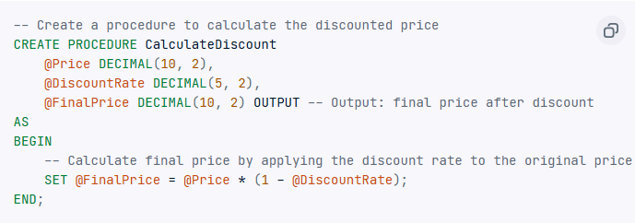
Home
About
Contact
Input and output parameters
Output parameters, defined by the OUTPUT keyword, allow a stored procedure to send a value back to the calling environment. For example, if a procedure calculates a discount, it could use an output parameter to pass it back to the calling program.

Slide 13
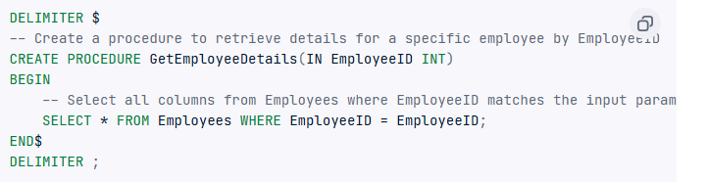
Home
About
Contact
Stored Procedures in MySQL
As I had mentioned, executing a stored procedure in SQL can be done in different ways depending on the database system and the tools used.
Creating stored procedures in MySQL
Creating a stored procedure in MySQL involves defining the procedure's name, parameters, and the SQL statements that make up its body. The following example creates a procedure called GetEmployeeDetails that takes EmployeeID as an input parameter and retrieves details for that specific employee.

Slide 14

Home
About
Contact
Executing stored procedures in MySQL
The most common way to execute a stored procedure is using SQL commands. In MySQL, we use the CALL command to execute the stored procedure.
Using the defined GetEmployeeDetails procedure, the execution query would look like this:

Slide 15
Home
About
Contact
Common Uses for Stored Procedures
SQL stored procedures are useful in scenarios where repetitive complex tasks are required. The following are real-world applications of stored procedures in data management and business operations.

Slide 16
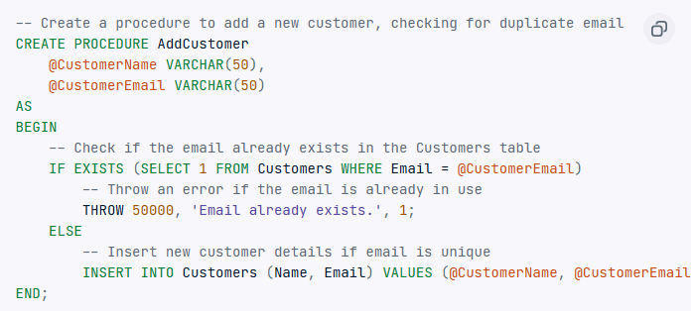
Home
About
Contact
Data validation and integrity enforcement
Stored procedures can be used to validate data before update or insertion. In the example below, a stored procedure checks that a customer’s email is unique before inserting a new record into the Customers table, ensuring data consistency. This centralizes validation logic within the database, reducing redundancy and ensuring uniform enforcement across different applications.

Slide 17
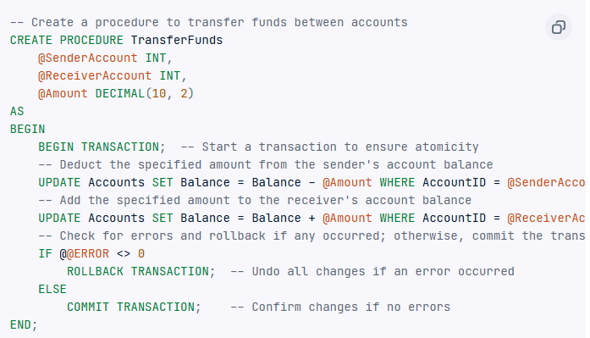
Home
About
Contact
Transaction management
By using stored procedures, you can ensure multiple operations are executed as a single transaction. For example, in a banking system, a stored procedure can handle both debit and credit actions in a funds transfer, making sure both actions succeed or fail together.

Slide 18
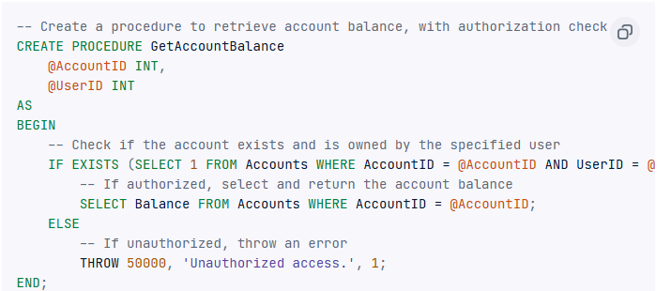
Home
About
Contact
Access control and data security
You can also use SQL stored to control data access to sensitive information. For example, a stored procedure can limit direct table access by allowing users to call a procedure that retrieves only relevant fields, such as account balances, without transaction details.

Slide 19
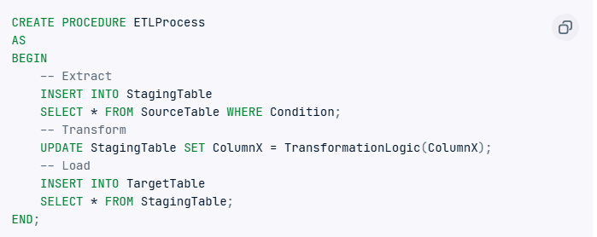
Home
About
Contact
Data migration and ETL processes
Stored procedures are also used to load, transform, and migrate data between systems. A stored procedure can automate data extraction from a source database, transform it as needed, and insert it into a target table, simplifying data integration for reporting or analysis.

Slide 20
Home
About
Contact
Best Practices for Stored Procedures
Writing efficient and maintainable stored procedures ensures your database performs optimally. The following are the tips for writing stored procedures for your SQL databases.
Use Consistent Naming Conventions: To make stored procedures easy to identify and understand, use a consistent and descriptive naming format. Also, avoid the sp_ Prefix in SQL Server reserved for system procedures to prevent potential conflicts and performance issues.
Implement Error Handling: Wrap SQL statements in TRY...CATCH blocks to catch and handle errors and maintain data integrity.

Slide 21
Home
About
Contact
Best Practices for Stored Procedures
Writing efficient and maintainable stored procedures ensures your database performs optimally. The following are the tips for writing stored procedures for your SQL databases.
Optimize for Performance: Minimize the use of cursors as they can be slow and resource-intensive. Instead, try using set-based operations, which are generally more efficient. Also, index the frequently used columns and avoid complex joins in large tables to reduce memory overhead and improve efficiency.
Parameterize Stored Procedures: Use parameters instead of hardcoded values to allow you to pass dynamic values into your procedure, making it more flexible and reusable.

Slide 22
Home
About
Contact
CRUD Operations using Stored Procedures with PHP and MySQL (via XAMPP)
Learning Objectives:
By the end of this lesson, students will be able to:
Understand what stored procedures are and why they are used.
Use PHP to interact with stored procedures in a MySQL database.
Implement Create, Read, Update, and Delete (CRUD) operations.
Build a web interface using HTML and CSS connected to stored procedures.

Slide 23
Home
About
Contact
Pros of Using Stored Procedures:
Security – Encapsulates business logic and hides raw table access
Stored procedures allow developers to control how the database is accessed. Instead of giving users or applications direct access to tables, you can allow them to call procedures. This hides the underlying data structure and helps enforce access rules, reducing the risk of SQL injection and unauthorized data manipulation.

Slide 24
Home
About
Contact
Pros of Using Stored Procedures:
Performance – Runs faster as it's precompiled in the database
Stored procedures are parsed and optimized by the database engine when they are first created, not each time they are run. This means they execute more efficiently, especially in repetitive or complex operations. The execution plan is already available, which saves processing time

Slide 25
Home
About
Contact
Pros of Using Stored Procedures:
Reusability – Reuse logic across multiple apps or pages
You can write a stored procedure once and call it from different parts of your system, whether it's a web app, desktop app, or reporting tool. This ensures consistency in logic (like calculations or data validation) and avoids duplicating code.

Slide 26
Home
About
Contact
Pros of Using Stored Procedures:
Maintainability – You only need to change the logic in one place
If business rules change (e.g., tax computation or approval process), you can simply update the stored procedure, and all applications calling it will automatically use the new logic. This makes debugging and updating faster and easier.

Slide 27
Home
About
Contact
Cons of Using Stored Procedures:
Complex Debugging – Debugging stored procedures can be harder than PHP scripts
Unlike PHP or other high-level languages that offer rich debugging tools (like breakpoints or step-through debugging), stored procedures often require manual testing, printing debug info with SELECT or RAISE NOTICE, and may not give clear error messages. This makes identifying and fixing issues more challenging.

Slide 28
Home
About
Contact
Cons of Using Stored Procedures:
Less Portability – Not easily portable between different database systems
Stored procedures are usually written in a database-specific language (like T-SQL for SQL Server or PL/pgSQL for PostgreSQL). This means code written for one system may not run on another without rewriting, making migration harder.

Slide 29
Home
About
Contact
Cons of Using Stored Procedures:
Requires DB Knowledge – Developers need to understand SQL in depth
To effectively write and maintain stored procedures, a developer must be proficient in SQL and database-specific features. This might be a hurdle for front-end or full-stack developers who are more familiar with application logic than with database internals.

Slide 30
Home
About
Contact
Cons of Using Stored Procedures:
Tight Coupling – Logic is tied closely to the database layer
Putting too much business logic in stored procedures can lead to a tightly coupled system where the application is heavily dependent on the database structure. This reduces flexibility, makes testing harder outside of the database, and complicates changes in either layer.

Slide 31
Home
About
Contact
Cons of Using Stored Procedures:
Tight Coupling – Logic is tied closely to the database layer
Putting too much business logic in stored procedures can lead to a tightly coupled system where the application is heavily dependent on the database structure. This reduces flexibility, makes testing harder outside of the database, and complicates changes in either layer.

Slide 32
Home
About
Contact
Thank You
FOR YOUR ATTENTION

